Slide 1
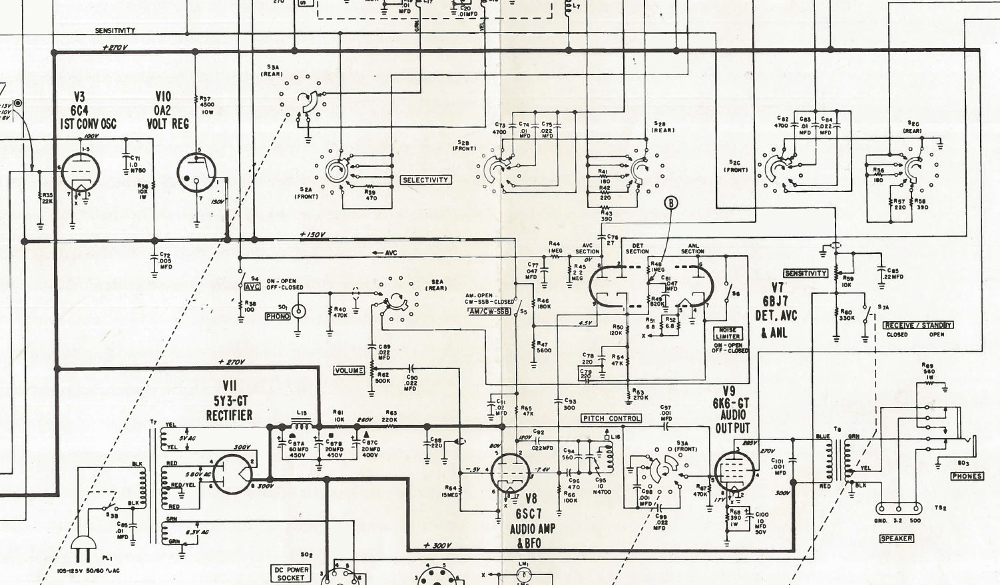

Slide 2
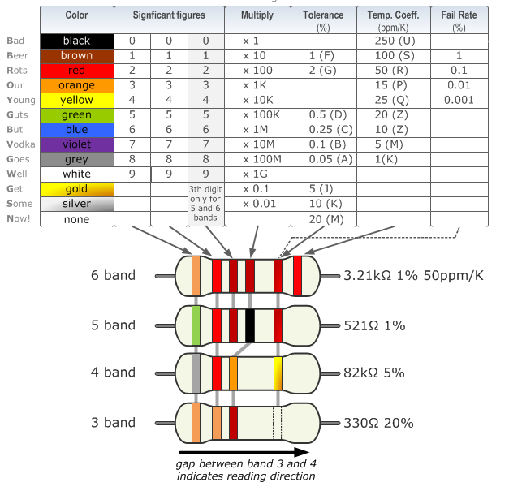

Slide 3
uF/ MFD | nF | pF/ MMFD | uF/ MFD | nF | pF/ MMFD
1uF / MFD | 1000nF | 1000000pF(MMFD) | 0.001uF / MFD | 1nF | 1000pF(MMFD)
0.82uF / MFD | 820nF | 820000pF (MMFD) | 0.00082uF / MFD | 0.82nF | 820pF (MMFD)
0.8uF / MFD | 800nF | 800000pF (MMFD) | 0.0008uF / MFD | 0.8nF | 800pF (MMFD)
0.7uF / MFD | 700nF | 700000pF (MMFD) | 0.0007uF / MFD | 0.7nF | 700pF (MMFD)
0.68uF / MFD | 680nF | 680000pF (MMFD) | 0.00068uF / MFD | 0.68nF | 680pF (MMFD)
0.6uF / MFD | 600nF | 600000pF (MMFD) | 0.0006uF / MFD | 0.6nF | 600pF (MMFD)
0.56uF / MFD | 560nF | 560000pF (MMFD) | 0.00056uF / MFD | 0.56nF | 560pF (MMFD)
0.5uF / MFD | 500nF | 500000pF (MMFD) | 0.0005uF / MFD | 0.5nF | 500pF (MMFD)
0.47uF / MFD | 470nF | 470000pF (MMFD) | 0.00047uF / MFD | 0.47nF | 470pF (MMFD)
0.4uF / MFD | 400nF | 400000pF (MMFD) | 0.0004uF / MFD | 0.4nF | 400pF (MMFD)
0.39uF / MFD | 390nF | 390000pF (MMFD) | 0.00039uF / MFD | 0.39nF | 390pF (MMFD)
0.33uF / MFD | 330nF | 330000pF (MMFD) | 0.00033uF / MFD | 0.33nF | 330pF (MMFD)
0.3uF / MFD | 300nF | 300000pF (MMFD) | 0.0003uF / MFD | 0.3nF | 300pF (MMFD)
0.27uF / MFD | 270nF | 270000pF (MMFD) | 0.00027uF / MFD | 0.27nF | 270pF (MMFD)
0.25uF / MFD | 250nF | 250000pF (MMFD) | 0.00025uF / MFD | 0.25nF | 250pF (MMFD)
0.22uF / MFD | 220nF | 220000pF (MMFD) | 0.00022uF / MFD | 0.22nF | 220pF (MMFD)
0.2uF / MFD | 200nF | 200000pF (MMFD) | 0.0002uF / MFD | 0.2nF | 200pF (MMFD)
0.18uF / MFD | 180nF | 180000pF (MMFD) | 0.00018uF / MFD | 0.18nF | 180pF (MMFD)
0.15uF / MFD | 150nF | 150000pF (MMFD) | 0.00015uF / MFD | 0.15nF | 150pF (MMFD)
0.12uF / MFD | 120nF | 120000pF (MMFD) | 0.00012uF / MFD | 0.12nF | 120pF (MMFD)
0.1uF / MFD | 100nF | 100000pF (MMFD) | 0.0001uF / MFD | 0.1nF | 100pF (MMFD)
0.082uF / MFD | 82nF | 82000pF (MMFD) | 0.000082uF / MFD | 0.082nF | 82pF (MMFD)
0.08uF / MFD | 80nF | 80000pF (MMFD) | 0.00008uF / MFD | 0.08nF | 80pF (MMFD)
0.07uF / MFD | 70nF | 70000pF (MMFD) | 0.00007uF / MFD | 0.07nF | 70pF (MMFD)
0.068uF / MFD | 68nF | 68000pF (MMFD) | 0.000068uF / MFD | 0.068nF | 68pF (MMFD)
0.06uF / MFD | 60nF | 60000pF (MMFD) | 0.00006uF / MFD | 0.06nF | 60pF (MMFD)
0.056uF / MFD | 56nF | 56000pF (MMFD) | 0.000056uF / MFD | 0.056nF | 56pF (MMFD)
0.05uF / MFD | 50nF | 50000pF (MMFD) | 0.00005uF / MFD | 0.05nF | 50pF (MMFD)
0.047uF / MFD | 47nF | 47000pF (MMFD) | 0.000047uF / MFD | 0.047nF | 47pF (MMFD)
0.04uF / MFD | 40nF | 40000pF (MMFD) | 0.00004uF / MFD | 0.04nF | 40pF (MMFD)
0.039uF / MFD | 39nF | 39000pF (MMFD) | 0.000039uF / MFD | 0.039nF | 39pF (MMFD)
0.033uF / MFD | 33nF | 33000pF (MMFD) | 0.000033uF / MFD | 0.033nF | 33pF (MMFD)
0.03uF / MFD | 30nF | 30000pF (MMFD) | 0.00003uF / MFD | 0.03nF | 30pF (MMFD)
0.027uF / MFD | 27nF | 27000pF (MMFD) | 0.000027uF / MFD | 0.027nF | 27pF (MMFD)
0.025uF / MFD | 25nF | 25000pF (MMFD) | 0.000025uF / MFD | 0.025nF | 25pF (MMFD)
0.022uF / MFD | 22nF | 22000pF (MMFD) | 0.000022uF / MFD | 0.022nF | 22pF (MMFD)
0.02uF / MFD | 20nF | 20000pF (MMFD) | 0.00002uF / MFD | 0.02nF | 20pF (MMFD)
0.018uF / MFD | 18nF | 18000pF (MMFD) | 0.000018uF / MFD | 0.018nF | 18pF (MMFD)
0.015uF / MFD | 15nF | 15000pF (MMFD) | 0.000015uF / MFD | 0.015nF | 15pF (MMFD)
0.012uF / MFD | 12nF | 12000pF (MMFD) | 0.000012uF / MFD | 0.012nF | 12pF (MMFD)
0.01uF / MFD | 10nF | 10000pF (MMFD) | 0.00001uF / MFD | 0.01nF | 10pF (MMFD)
0.0082uF / MFD | 8.2nF | 8200pF (MMFD) | 0.0000082uF / MFD | 0.0082nF | 8.2pF (MMFD)
0.008uF / MFD | 8nF | 8000pF (MMFD) | 0.000008uF / MFD | 0.008nF | 8pF (MMFD)
0.007uF / MFD | 7nF | 7000pF (MMFD) | 0.000007uF / MFD | 0.007nF | 7pF (MMFD)
0.0068uF / MFD | 6.8nF | 6800pF (MMFD) | 0.0000068uF / MFD | 0.0068nF | 6.8pF (MMFD)
0.006uF / MFD | 6nF | 6000pF (MMFD) | 0.000006uF / MFD | 0.006nF | 6pF (MMFD)
0.0056uF / MFD | 5.6nF | 5600pF (MMFD) | 0.0000056uF / MFD | 0.0056nF | 5.6pF (MMFD)
0.005uF / MFD | 5nF | 5000pF (MMFD) | 0.000005uF / MFD | 0.005nF | 5pF (MMFD)
0.0047uF / MFD | 4.7nF | 4700pF (MMFD) | 0.0000047uF / MFD | 0.0047nF | 4.7pF (MMFD)
0.004uF / MFD | 4nF | 4000pF (MMFD) | 0.000004uF / MFD | 0.004nF | 4pF (MMFD)
0.0039uF / MFD | 3.9nF | 3900pF (MMFD) | 0.0000039uF / MFD | 0.0039nF | 3.9pF (MMFD)
0.0033uF / MFD | 3.3nF | 3300pF (MMFD) | 0.0000033uF / MFD | 0.0033nF | 3.3pF (MMFD)
0.003uF / MFD | 3nF | 3000pF (MMFD) | 0.000003uF / MFD | 0.003nF | 3pF (MMFD)
0.0027uF / MFD | 2.7nF | 2700pF (MMFD) | 0.0000027uF / MFD | 0.0027nF | 2.7pF (MMFD)
0.0025uF / MFD | 2.5nF | 2500pF (MMFD) | 0.0000025uF / MFD | 0.0025nF | 2.5pF (MMFD)
0.0022uF / MFD | 2.2nF | 2200pF (MMFD) | 0.0000022uF / MFD | 0.0022nF | 2.2pF (MMFD)
0.002uF / MFD | 2nF | 2000pF (MMFD) | 0.000002uF / MFD | 0.002nF | 2pF (MMFD)
0.0018uF / MFD | 1.8nF | 1800pF (MMFD) | 0.0000018uF / MFD | 0.0018nF | 1.8pF (MMFD)
0.0015uF / MFD | 1.5nF | 1500pF (MMFD) | 0.0000015uF / MFD | 0.0015nF | 1.5pF (MMFD)
0.0012uF / MFD | 1.2nF | 1200pF (MMFD) | 0.0000012uF / MFD | 0.0012nF | 1.2pF (MMFD)
0.001uF / MFD | 1nF | 1000pF (MMFD) | 0.000001uF / MFD | 0.001nF | 1pF (MMFD)

