Slide 1
Course Medical TEAM 12
Preliminary
Location: Jackson Blvd. between Damen
Ave. and Ogden Ave.
Mile 15.7
October 9, 2022

Slide 2
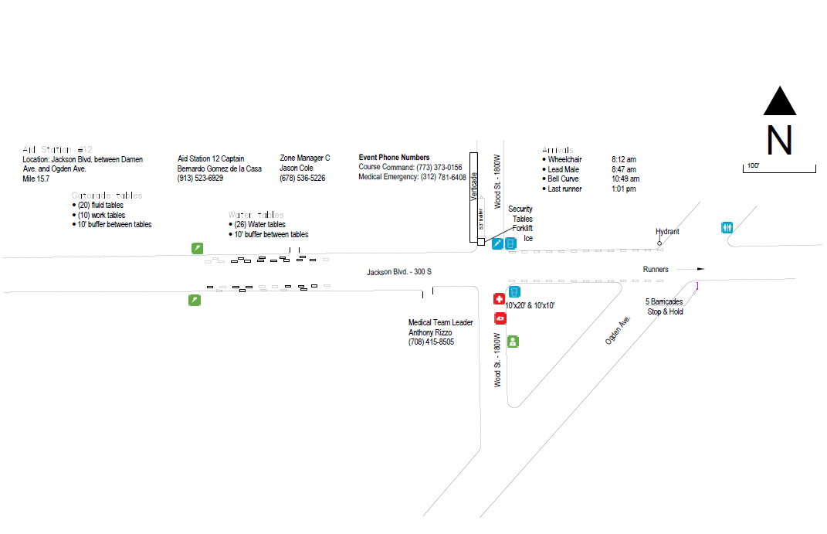
Our location
We will setup here behind the medical tent.
Location information provided by Rob Orr

Slide 3
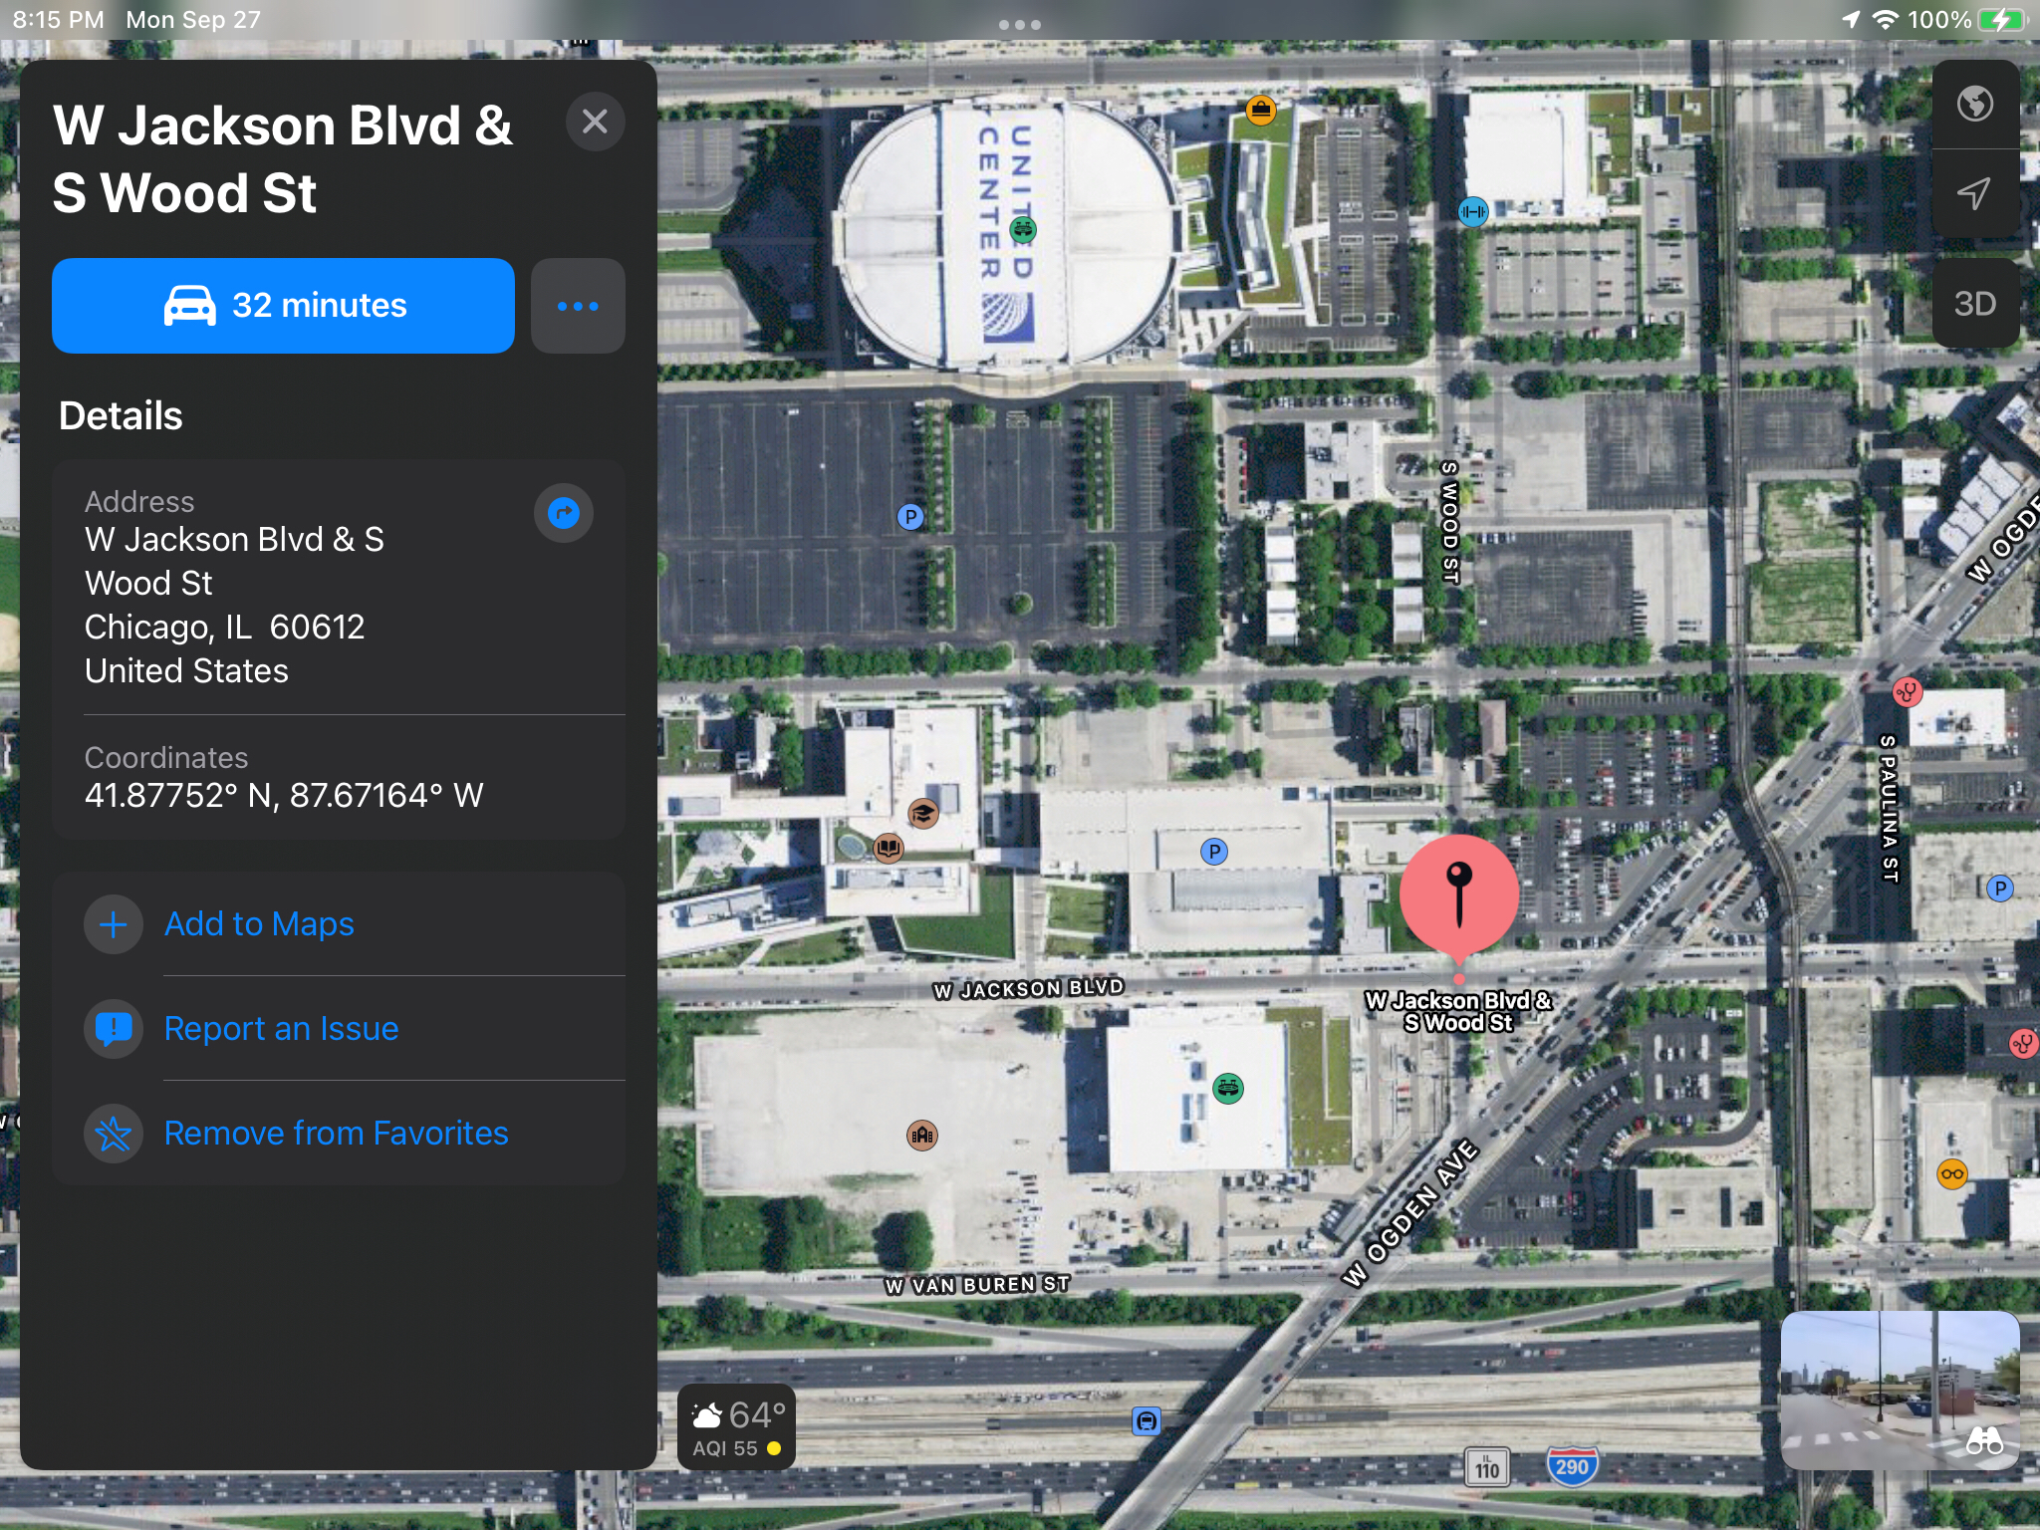
Our location

Slide 4
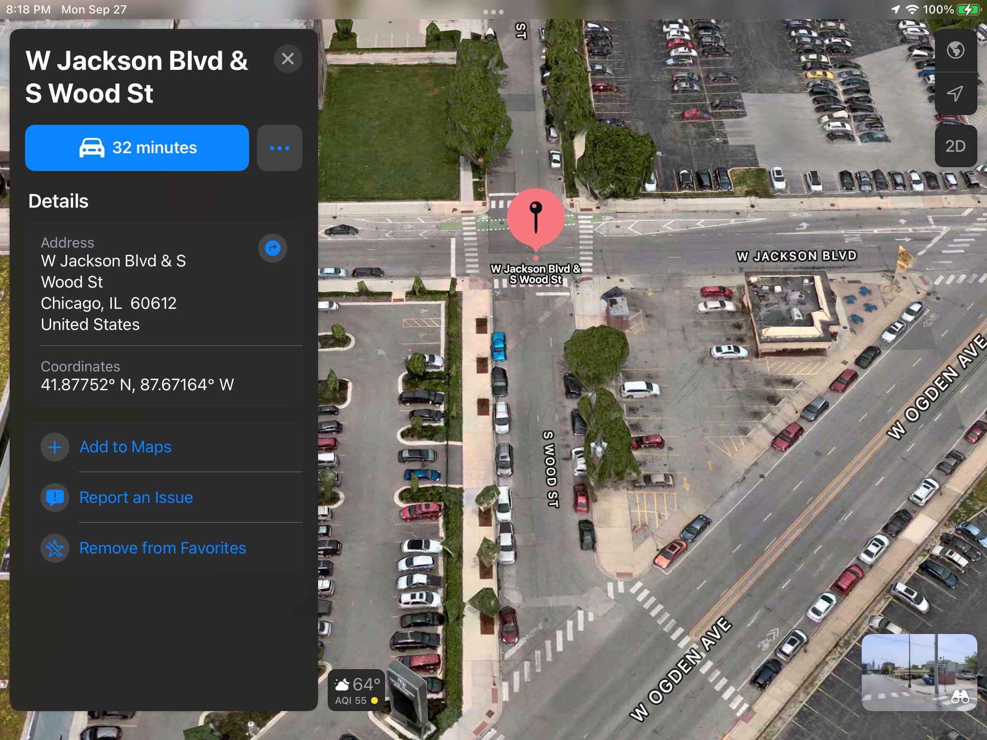
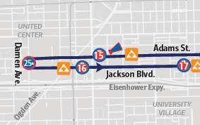
Our location

Slide 5
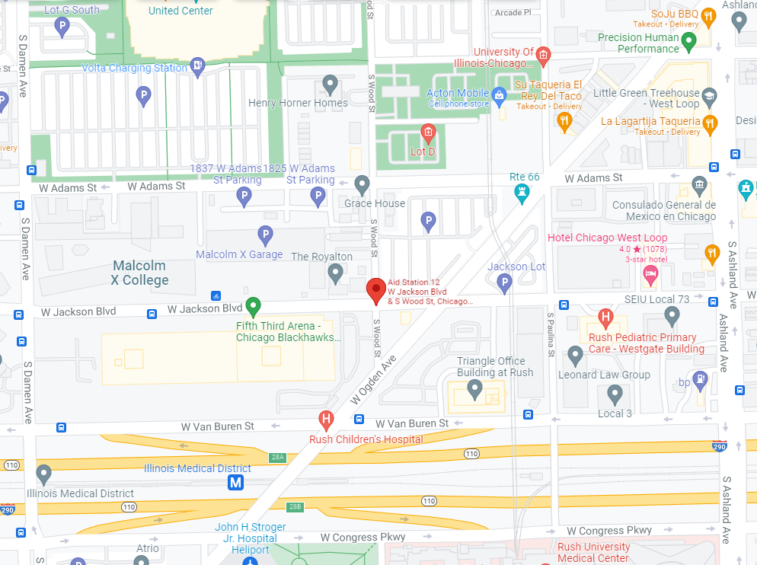
41.87769, -87.67162
Our location
https://goo.gl/maps/pCMarADNRxo43ZKj7

Slide 6
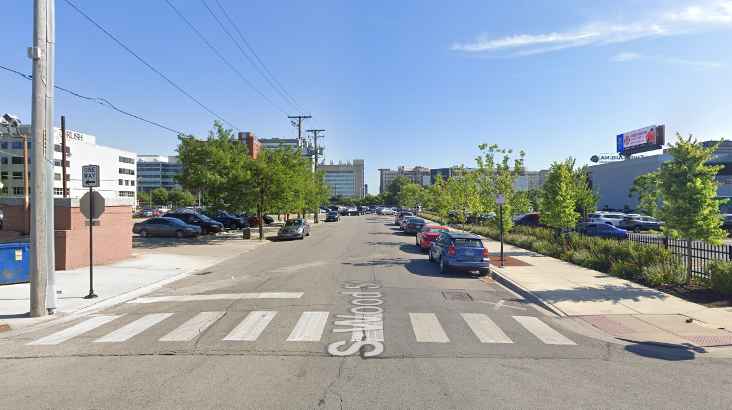
Our location
Street view: Looking south from Jackson Blvd.

Slide 7
General radio notes
When initiating radio contact, call the called party first, and then give your tactical call
For example for us: "Log Net, Med 12", not "Med 12 to Log Net Control."
  This is referred to as the “Hey you, it’s me” format.
Remember to hold the push-to-talk for one-second before transmitting.
Always name the Net Control you are calling.
Think of what you need to say, and then say it. Don't compose your message on-the-air.
Be clear and concise. Always use plain language.
Make sure every message is acknowledged. Repeat message to confirm.
Close your conversation with a simple: Understood, Clear, Message received, or simply, Thank you. End with your call sign.
Remember - The world is listening to everything you say.
Do not use proper names over the air: Never refer to the medical Doc in charge by name. He is called Top Doc.
Do not use ham jargon, "10"-codes, etc. Use "message received" for QSL. Use "affirmative" and "negative", "roger", "over", "say again", and so on. Always use plain language.
Use Break Tags (as described below).

Slide 8
Medical Net
Med Net communications are typically for an ambulance dispatch to take a patient to a hospital or a different medical facility. When you call in with a report please provide:
• Runner’s bib number – no names
• Condition (reason for transport in very simple terms, broken leg, exhaustion) and
• Your location – CMT12.
At each Course Medical Tent, we typically have one mobile radio operator to monitor this channel for your location.

Slide 9
Logistics Net
A. Medical Supplies. This can be almost anything from…do you have enough supplies? Keep in mind that it is often not easy or practical to get more supplies to you once the event has started. We will do our best, but it can be very challenging – and take time.
B. Police or Fire Dept support. Do you need a hydrant opened? Do you need crowd control?
C. Stress and Pace measures. Every 30 minutes, we will request reports via the Log Nets from each Course Medical Tent for data you collect from your medical team. We might increase the polling for the last 9 stations to every 15 minutes, if demand is high. One member of your team must find the person from the medical team in charge of collecting this information (more details are in the “Assignments – Details” section of this Guidebook.) Work out a method that works for your team.
D. EAS flags. Event Alert System. Each ham station/Course Medical Tent is responsible for displaying the proper colored flag letting people know the condition of the course. You will be told what color should be flying. Improvise a solution if your EAS flag does not have a stand that works! See APPENDIX A FOR DETAILS ON EAS

Slide 10
Logistics Net
E. Weather data. We will be asking stations on the extreme ends of the course to provide weather data on a schedule to be announced. These are Course Medical Tents 6, 11, 18.
F. End of Race Vehicle. Please report the time when the event trail car passes your Course Medical Tent.
G. Report Medical Team arrival and dismissal. In the morning, we may ask you to report when your medical team arrives. After the event, you will not be dismissed until the medical team has been transported.
H. Report disposition of the Biohazard Bag. Please report that the biohazard bag has been removed from the scene. Report the time it was picked up (It is supposed to leave with the doctors when the Course Medical Tent is closed. Remember: your team does not leave until that bag is gone. If it is left behind, you own it and must return it to Jackson Hospital in Grant Park!

Slide 11
Logistics Net - break tags
Break Tags - Quick ways to get the attention of the other station without much conversation…simply say:
Answer: To be used when you have the definitive answer to a question currently being discussed on the air.
Question: To be used when the answer to a question can't wait; for example, when the mayor is standing next to you and requesting you to get information using your radio.
Info: To be used when information needs to be transmitted rapidly but is not related to what is being said on the air; for example, if an event that net control needs to know about is going to happen in the next few seconds or if waiting for the end of an exchange will negate the value of the information.
Priority: To be used to report an important but not life-threatening situation such as a fender bender that just happened.
Medical: To be used to report a minor medical incident that affects the operator in some way; for example, having to leave his/her post for a few minutes to walk someone with a minor cut over to a med tent.
Emergency: Only to be used to report an ongoing life or property threatening or damaging incident.
Break Med 12: An indication that the operator has traffic that can wait and does not require the cessation of the ongoing exchange. This tag has an expectation to be put on hold and in queue for transmission.

Slide 12
Logistics Net - Pace
PACE – How many people have you treated since the last reporting period? We realize that this information might be in several different places within the Course Medical Tent ... but the hams will give the medical team a 10-minute lead to collect the data. The number we want is: How many patients have been treated SINCE THE LAST REPORTING PERIOD?!
NEW: It has been suggested that the hams seek out the paper records and count the sheets since your last report. That is all we want ... the number since your last reporting period. Leave a mark on the form so you know where you left off for the next reporting period.
PACE is a fairly straight forward accounting of the number of people that have been treated since the last reporting period (typically every 30 minutes.)

Slide 13
Logistics Net - stress
STRESS - For Stress, you will need to ask the doctor or his representative how things are proceeding, use the grading scale below. You might have this form available for him to make his best judgement. (Stress Level based on patients, staff, supplies and support)– this is more complex, and somewhat subjective. This is a number on a scale from 1 to 5 based on the following general conditions:
Stress is subjective and will be reported with PACE. I am expecting guidance to change with the release of the guidebook so stay tuned for more information here.

Slide 14
Be prepared
Item | Notes
HT | Programmed with race frequencies
Charged batteries, spare batteries for HT
Chair
Operator Guidebook | Bill will bring a printed copy
Reflective vest | Should be provided but if you have your own I would bring it
Flashlights, headlamps, lantern | Sunrise @ 0700
Pens, paper/notebook | For general notetaking
Snacks / medication | Food may be provided but don’t count it
Multi-tool or small tool set
Tarps, baggies | In case of rain to protect equipment
If you see something – say something

Slide 15
Have fun!!

